Slide 1



Spreadsheet
Class VI
lab 23

Slide 2
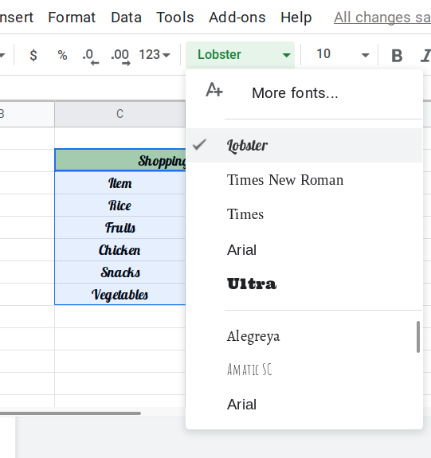
Font
You can use any of your desired font from the font family

Slide 3
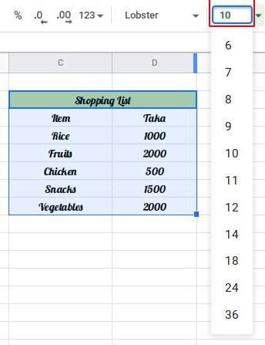
Font Size
You ca resize your font by mentioning the font size.

Slide 4
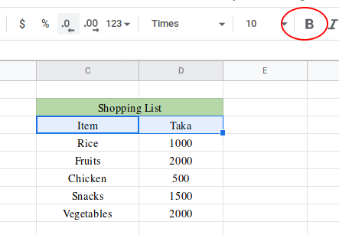
Bold Font
Mark area and Click on B from menu to bold text

Slide 5
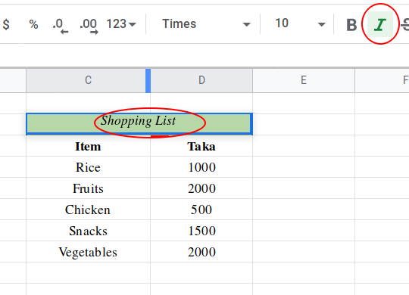
Italic Font
Mark area and Click on I from menu to italic text

Slide 6
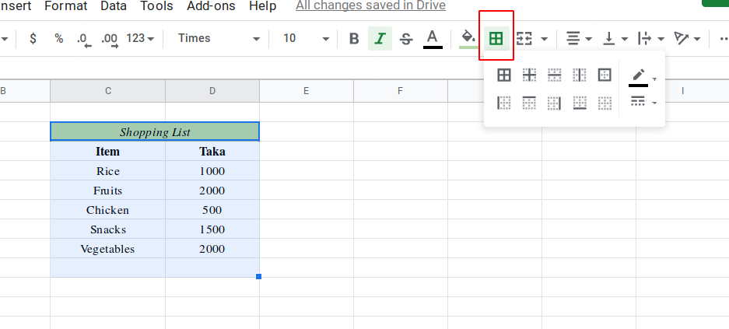
Border Specific Area
Mark area and choose border type

Slide 7
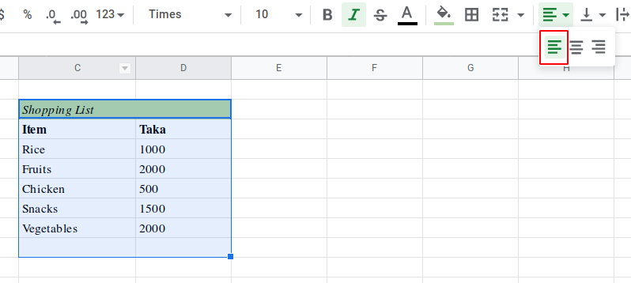
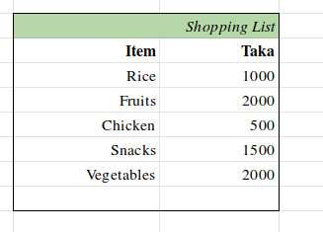
Text Alignment
you can send your text to left, middle or right corner

Slide 8



